Slide 1



OOP - Fundamentals
Abstraction, Encapsulation and Inheritance
SoftUni Team
Technical Trainers
Software University
http://softuni.bg

Slide 2


Table of Contents
Fundamental Principles of OOP
Abstraction
Hide complexity
Encapsulation
Access modifiers
Inheritance
Class hierarchies
Inheritance and access levels

Slide 3
Questions
sli.do #PHPFUND

Slide 4
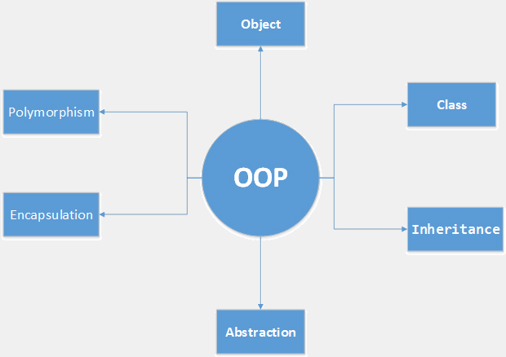
Fundamental Principles of OOP
Notes:
(c) 2006 National Academy for Software Development - http://academy.devbg.org*
4##

Slide 5
Fundamental Principles of OOP
Abstraction
Hide complexity
Encapsulation
Hide internal data
Inheritance
Inherit members from parent class
Inherit constructor from parent class
Polymorphism

Slide 6
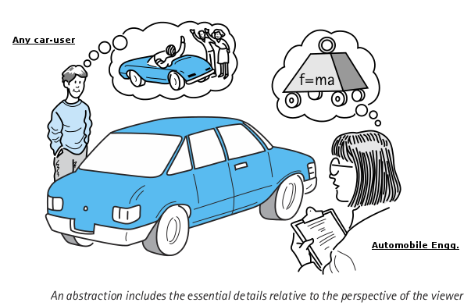
Abstraction

Slide 7
Abstraction
Hides all but the relevant data about an object in order to reduce complexity and increase efficiency.
Abstraction is a concept that takes place anywhere in a software system where 'making things more general/simpler/abstract' is involved.
An inheritance hierarchy, where the higher classes are simpler or more general, and define more general and abstract implementation. While the lower classes in the hierarchy are more concrete and define more detailed implementations.
Using encapsulation to hide the details of implementation of a class from other classes, thus making the class more 'abstract' (simpler) to the outside software world.
Notes:
Encapsulation hides the implementation details
Class announces only a few operations (methods) available for its clients – its public interface
All data members (fields) of a class should be hidden
Accessed via properties (read-only and read-write)
No interface members should be hidden
Encapsulation == hide (encapsulate) data behind constructors and properties

Slide 8
Abstraction - Example
Let's take DateTime class as an example
We know how to use the methods without worrying how they do their job
DateTime implements DateTimeInterface {
public DateTime add(DateInterval $interval)
public DateTime setTimestamp(int $unixtimestamp)
public DateTime setTimezone(DateTimeZone $timezone)
public DateInterval diff(DateTimeInterface $datetime2 [, bool $absolute = false ])
}

Slide 9

Encapsulation

Slide 10
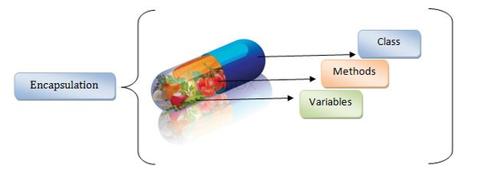
Encapsulation
Encapsulation is a concept of wrapping up or binding up related data members and methods in a single module.
Restricting direct access to members where necessary using setters and getters
Notes:
Encapsulation hides the implementation details
Class announces only a few operations (methods) available for its clients – its public interface
All data members (fields) of a class should be hidden
Accessed via properties (read-only and read-write)
No interface members should be hidden
Encapsulation == hide (encapsulate) data behind constructors and properties

Slide 11
Visibility
There are three visibility levels in PHP
Available only to the class and its
children
class Person {
protected $age;
private $gender;
public function __construct($age, $gender) {
$this->setAge($age);
$this->setGender($gender);
}
public function setAge($age) {
$this->age = $age;
}
Available only to the class itself
Available everywhere
Notes:
Encapsulation hides the implementation details
Class announces only a few operations (methods) available for its clients – its public interface
All data members (fields) of a class should be hidden
Accessed via properties (read-only and read-write)
No interface members should be hidden
Encapsulation == hide (encapsulate) data behind constructors and properties

Slide 12
Visibility (2)
public function setGender($gender) {
$this->gender = $gender;
}
public function getGender() {
return $this->gender;
}
public function getAge() {
return $this->age;
}
}
$newPerson = new Person(12, "male");
echo $newPerson->getGender();
Notes:
Constructors are declared public
Constructors perform checks to keep the object state valid
Interface methods are always public
Not explicitly declared with public
Non-interface methods are declared private / protected

Slide 13
Getters and Setters
You can define your own setters and getters
Using getters and setters you can control data validation
public function getAge() {
return $this->age;
}
public function setAge($age) {
if ($age < 18)
throw new Exception('Should be an adult');
else
$this->age = $age;
}
Notes:
Constructors are declared public
Constructors perform checks to keep the object state valid
Interface methods are always public
Not explicitly declared with public
Non-interface methods are declared private / protected

Slide 14
Magic Setters and Getters
__set() is run when writing data to inaccessible properties
__get() is utilized for reading data from inaccessible properties
Data validation is not so flexible this way
public function __set($name, $value) {
$this->{$name} = $value;
}
public function __get($name) {
return $this->{$name};
}
Notes:
Exception in PHP is an object, which signals an error or an event, which is not anticipated in the normal program flow. When such unusual event takes place, the executing method ’throws' a special object containing information about the type of the error, the place in the program where the error occurred as well as the program state at the moment of the error.
Each exception in PHP contains the so-called stack trace, which gives information of where exactly the error occurred.

Slide 15
Problem: Employee Class
Every Employee should have:
First and last name
Salary and age
Salary should not be visible outside the class but visible for child classes
Salary should be bigger than 0 and must have a way to increase that salary. Lowest increase is 10%
Every employee should be at least 16 years old

Slide 16
Solution: Employee Class
class Employee {
public $fname;
public $lname;
protected $salary;
private $age;
public function __construct($fname, $lname, $age, $salary) {
$this->fname = $fname;
$this->lname = $lname;
$this->setSalary($salary);
$this->setAge($age);
}

Slide 17
Solution: Employee Class (2)
public function increaseSalary($increase) {
if ($increase < 10) {
throw new Exception('Invalid increase');
}
$this->salary *= (1 + $increase / 100);
}
public function setSalary($salary) {
if ($salary < 1) {
throw new Exception('Invalid salary');
}
$this->salary = $salary;
}

Slide 18
Solution: Employee Class (3)
public function setAge($age) {
if ($age < 16) {
throw new Exception('Invalid age');
}
$this->age = $age;
}
}
$employee = new Employee('Gosho','Petrov',25,5000);
$employee->increaseSalary(15);

Slide 19

Encapsulation
Live Exercises in Class

Slide 20
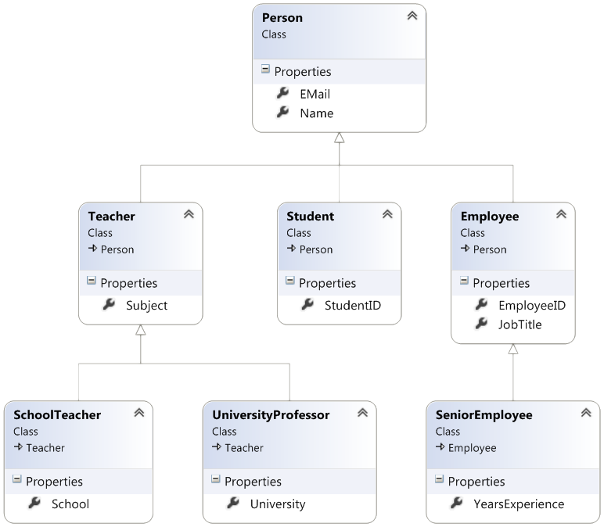
Inheritance
Notes:
(c) 2006 National Academy for Software Development - http://academy.devbg.org*
20##

Slide 21
Class Inheritance
Base (parent, super) class
Classes can inherit (extend) other classes
Child class inherits data + methods from its parent
Child class can:
Add properties (data)
Add / replace methods
Add / replace accessor properties
Person
name
email
Child (derived) class
Teacher
subject

Slide 22
Class Inheritance – Example
class Person {
function __construct($name, $email) {
$this->name = $name;
$this->email = $email;
}
}
Person
name
class Teacher inherits Person
email
class Teacher extends Person {
function __construct($name, $email, $subject) {
parent::__construct($name, $email);
$this->subject = $subject;
}
}
Teacher
subject
Invoke the parent constructor

Slide 23
Class Inheritance – Example (2)
$p = new Person("Maria", "maria@gmail.com");
echo "Person: " .
$p->name . ' (' . $p->email . ')';
// Person: Maria (maria@gmail.com)
$t = new Teacher("Ivan", "iv@yahoo.com", "PHP");
echo "Teacher: " . $t->name .
' (' . $t->email . '), teaches ' . $t->subject .')';
// Teacher: Ivan (iv@yahoo.com), teaches PHP

Slide 24
Accessing Parent Members
Person
name
email
__toString()
Teacher
Student
Invoking Parent Methods
subject
course
__toString()
__toString()

Slide 25
Inheriting and Replacing __toString() – Person
class Person {
function __construct($name, $email) {
$this->name = $name;
$this->email = $email;
}
function __toString() {
$className = get_class($this);
return $className . '(name: ' . $this->name . ', email: ' . $this->email . ')';
}
}

Slide 26
Inheriting and Replacing __toString() – Teacher
class Teacher extends Person {
function __construct($name, $email, $subject) {
parent::__construct($name, $email);
$this->subject = $subject;
}
function __toString() {
$parentString = parent::__toString();
return $parentString . ' subject: ' . $this->subject . ')';
}
}
Invoke __toString() from the base (parent) class

Slide 27
Inheriting and Replacing __toString() – Student
class Student extends Person {
function __construct($name, $email, $course) {
parent::__construct($name, $email);
$this->course = $course;
}
function __toString() {
$parentString = parent::__toString();
return $parentString . ' course: ' . $this->course . ')';
}
}
Invoke __toString() from the base (parent) class

Slide 28
Inheriting and Replacing toString() – Usage
$p = new Person("Maria", "maria@gmail.com");
echo $p;
// Person (name: Maria, email: maria@gmail.com)
$t = new Teacher("Ivan", "iv@yahoo.com", "PHP");
echo $t;
// Teacher (name: Ivan, email: iv@yahoo.com, subject: PHP)
$s = new Student("Ana", "ana@mail.ru", 3);
echo $s;
// Student (name: Ana, email: ana@mail.ru, course: 3)

Slide 29
Inheritance: Important Aspects
There is no multiple inheritance
Constructors are not inherited
Parent constructors are not called implicitly by the engine
Extended class could add new members, but couldn’t remove derived members
New members with the same name hide the inherited ones
Private members are accessible through the parent setters and getters
Public and Protected members are overwritten

Slide 30
Try to Build This Hierarchy
Game
SinglePlayerGame
MultiplePlayersGame
Minesweeper
Solitaire
BoardGame
Chess
Backgammon

Slide 31
Inheritance
Live Exercises in Class

Slide 32

Summary
Abstraction
Reduces complexity
Encapsulation
Hides internal data
Ensures that structural changes remain local
Access modifiers
Inheritance allows extending the behavior of the classes
Inheriting properties
Inheriting methods
Reusing the existing code

Slide 33








OOP Fundamentals
https://softuni.bg/courses/php-basics/

Slide 34
License
This course (slides, examples, demos, videos, homework, etc.) is licensed under the "Creative Commons Attribution-NonCommercial-ShareAlike 4.0 International" license
Attribution: this work may contain portions from
"PHP Manual" by The PHP Group under CC-BY license
"PHP and MySQL Web Development" course by Telerik Academy under CC-BY-NC-SA license

Slide 35





Free Trainings @ Software University
Software University Foundation – softuni.org
Software University – High-Quality Education, Profession and Job for Software Developers
softuni.bg
Software University @ Facebook
facebook.com/SoftwareUniversity
Software University @ YouTube
youtube.com/SoftwareUniversity
Software University Forums – forum.softuni.bg

